Slide 1
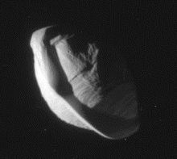
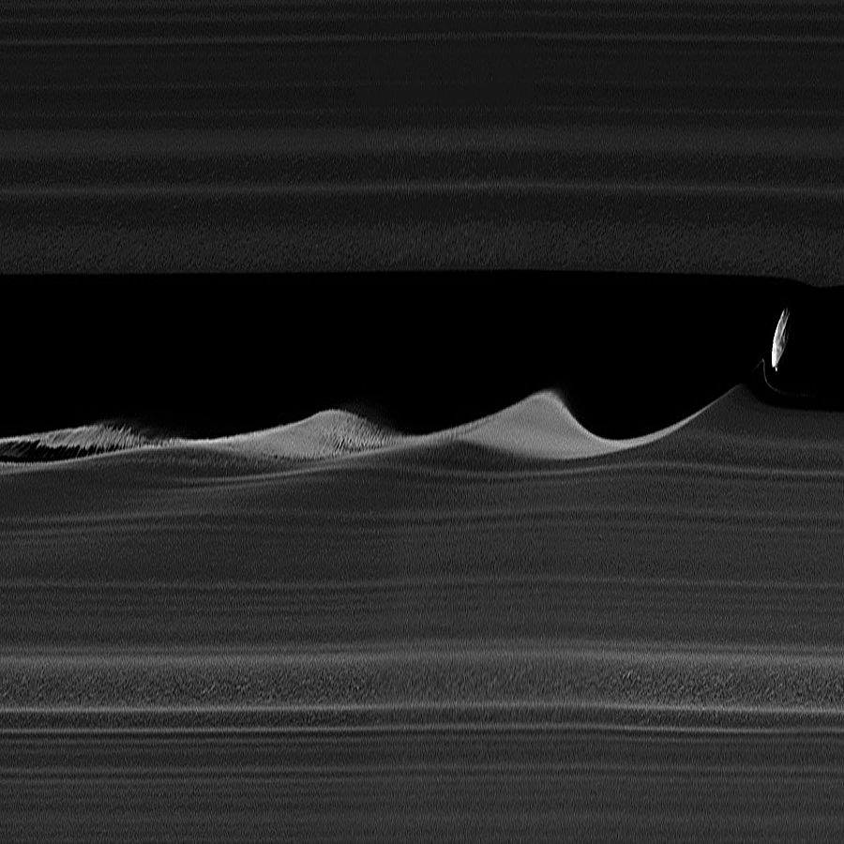
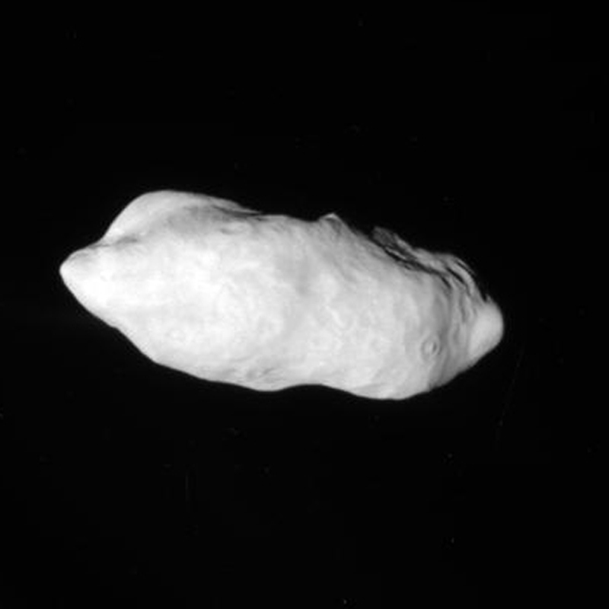
Pan, Daphnis, and Prometheus
By Corinne Komlodi

Slide 2
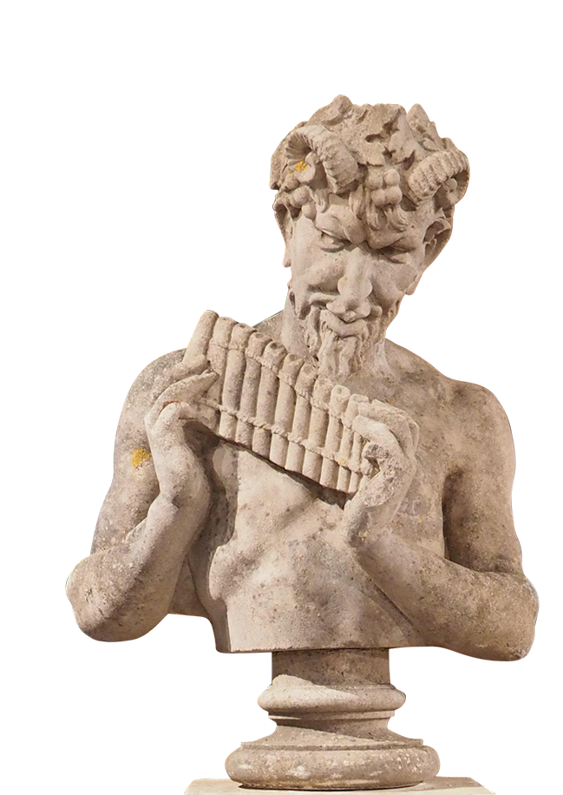
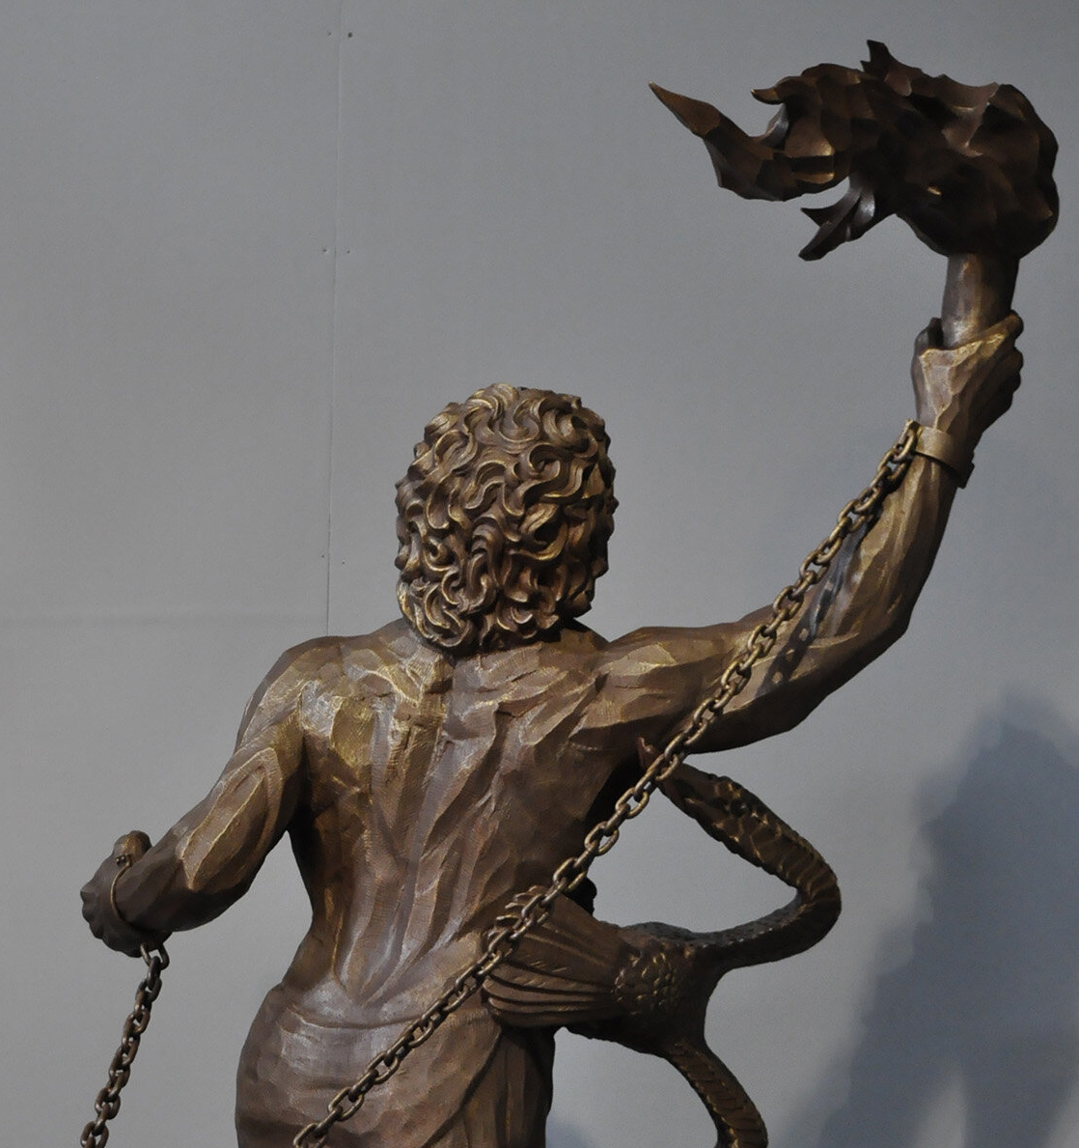
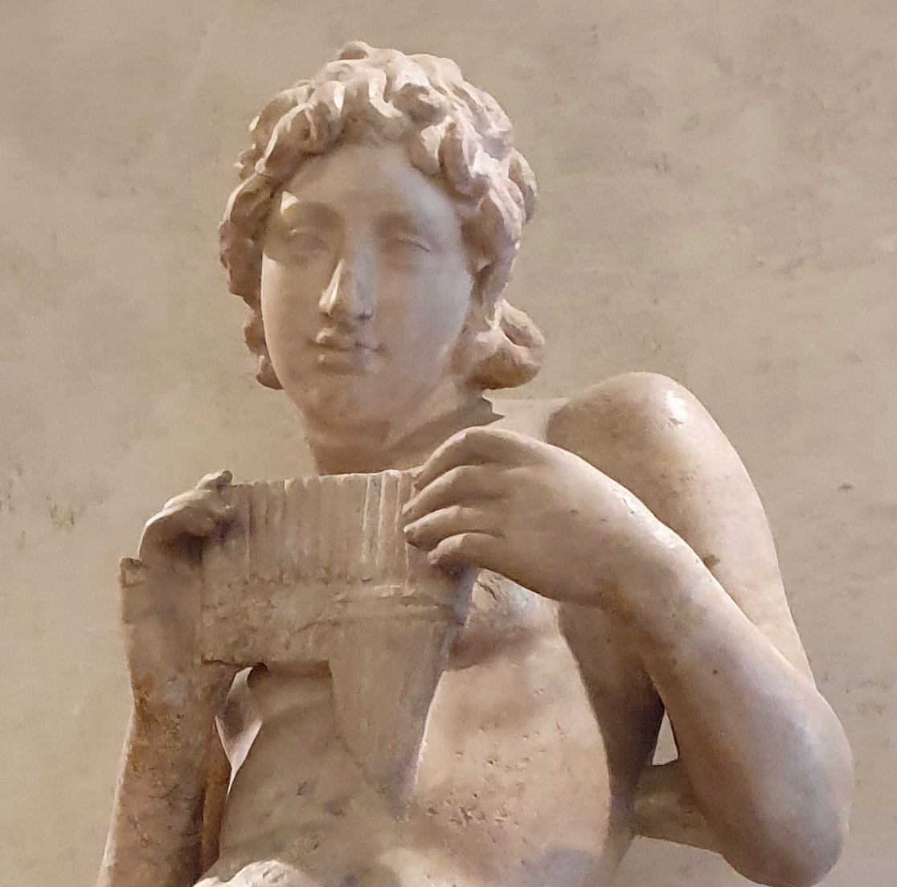
History
Pan
Discovered by M.R. Showalter in 1990
Voyager 2- 1981
Pan is derived from a satyr in Greek lore and is the god of the forest and nature.
Daphnis
Hypothesized to exist due to ripples along the keeler gap
Discovered May 1, 2005, by the Cassini team
Named from Greek myth, both brother to pan and son of Hermes, Daphnis was raised by a goatherd.
Prometheus
Discovered October 1980 by the Voyager 1 team
Named after the son of a titan and brother to atlas (most famous for holding the sky) and is known for stealing fire and bringing it to humanity
[1]
[3]
[2]

Slide 3
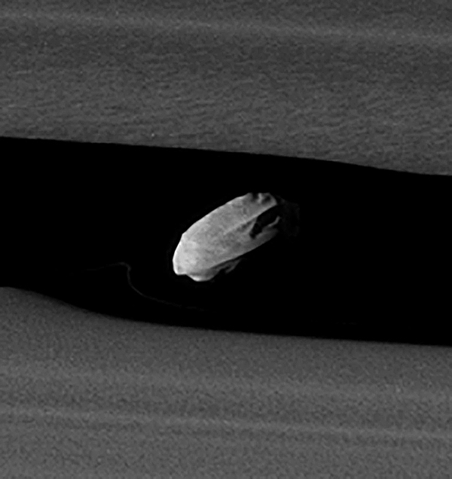
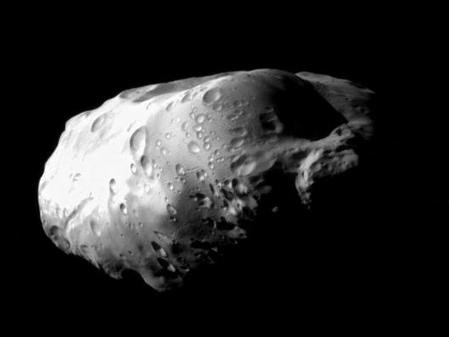
Physical Characteristics/ Formation Theory
Pan
Radius: 8.8 miles
Walnut-shaped and theorized to be made of denser material than the rings around it.
Has a distinct ring around its equator, theorized to have been accreted after rings flattened
Daphnis
Only 5 miles in radius
Less dense than water at 0.34±0.26 g/cm³
Tidally locked to Saturn
About 78K
More notable for its interaction with the A-ring
Prometheus
28.6 miles mean radius and 74K
Potato-shaped with visible craters up to 12.4 miles in diameter.
Less cratered than its neighbors, Pandora, Janus, and Epimetheus
Assumed to be low-density, high-porosity and made mostly of ice
[4]
[5]
[3]

Slide 4
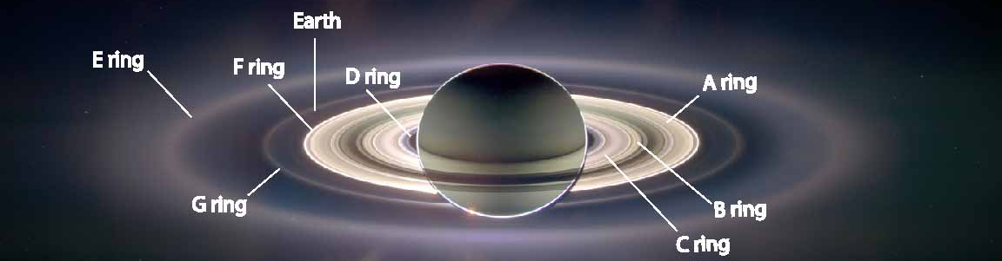
Orbital Parameters
Pan
13.8-hour period
Keeps the Encke gap open in the A-ring
Similar to Daphnis, creates wakes in the material closer to Saturn and effects the motion for 100+ miles.
Not as visually prominent as Daphnis
Daphnis
14-hour orbital period
Chaotic orbit (more from the paper)
Located in the A-ring, or keeler gap
Creates higher-dimensional waves in the rings. (Also known as rippling or saw tooth shadows)
Prometheus
14.7-hour period
Located next to the F-ring
Works with neighbor Pandora to maintain a thin separation
Appears to steal some of the material in between, hence the name of the fire thief
Confined/stable Chaotic orbit due to proximity and resonance
Notes:
Confined/ stable chaotic orbit refers to a system with a very short Lyapunov time but no significant radial component.

Slide 5
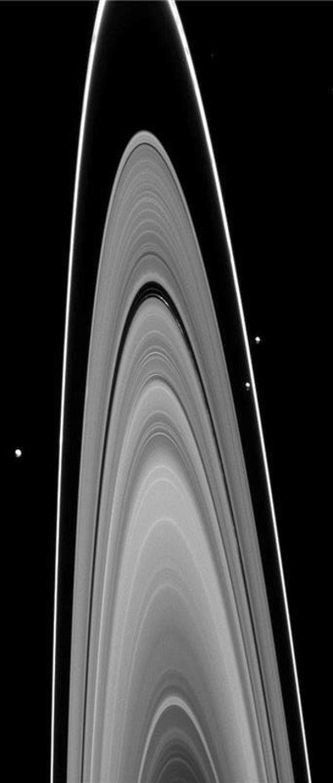
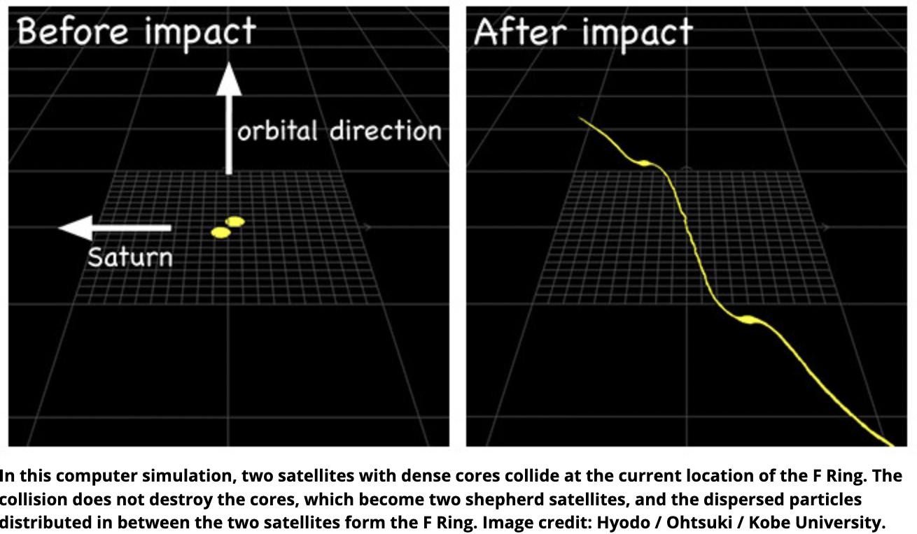
Clues about its Parent
F-ring
The F ring is theorized to have been created by a collision of two dense cores leaving behind the shepherds and the excess of material in the middle
In Saturn’s original protoplanetary disk
Main Ring System
Saturn's rings are at a weird tilt ~ 27°
Several Theories Exist:
Tidal destruction of a moon leaving behind material
Most of this material was swallowed by Saturn
Resonance with Neptune, which destabilized a large moons orbit, shattering it, and creating rings
[6]
[7]

Slide 6
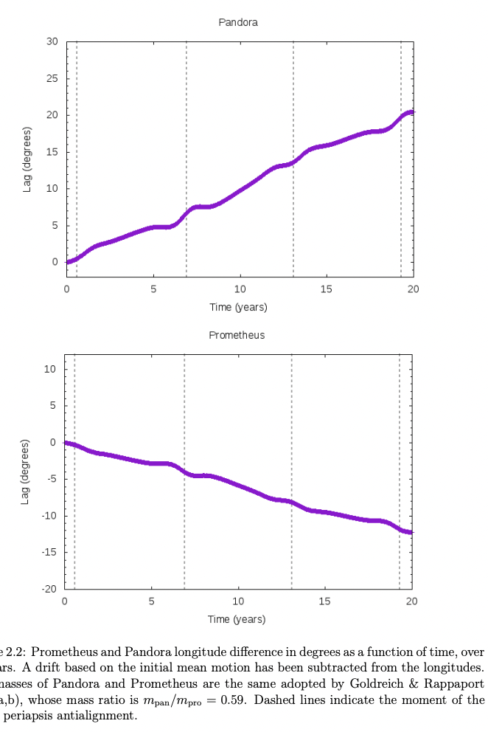
Mean motion resonances among the small satellites of Saturn and Pluto by Thamiris de Santana Masters Thesis 2019
Lyapunov time – ”the timescale on which a dynamical system is chaotic”
Pluto: 20 million years
The Solar System: 5 million years
Demonstrated the lag between Prometheus and pandora is caused by a 121:118 resonance (see figure next slide)
Analyzed the motion and graviaitonal influence of Pandora and Prometheus as a whole by using their mass ratios
The variation for pandora is always larger due to its smaller size

Slide 7
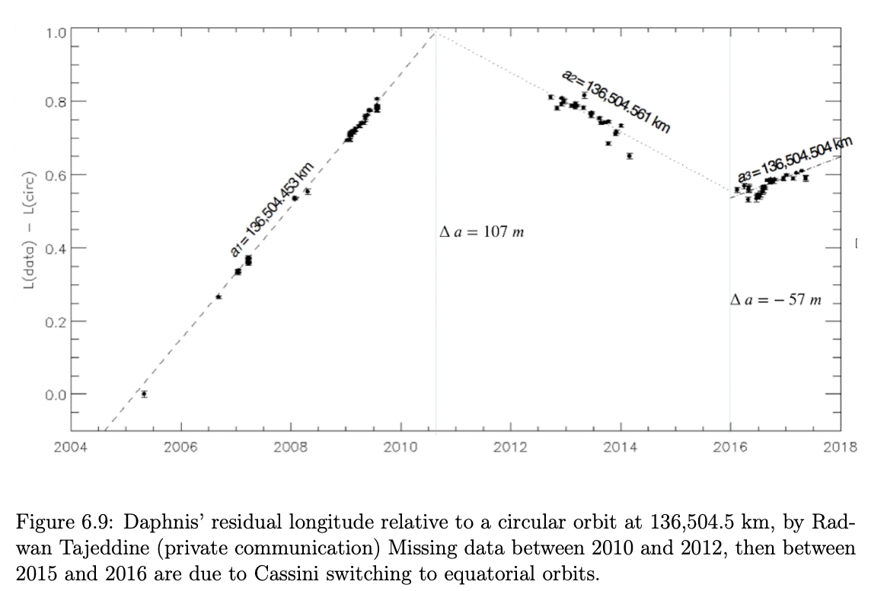
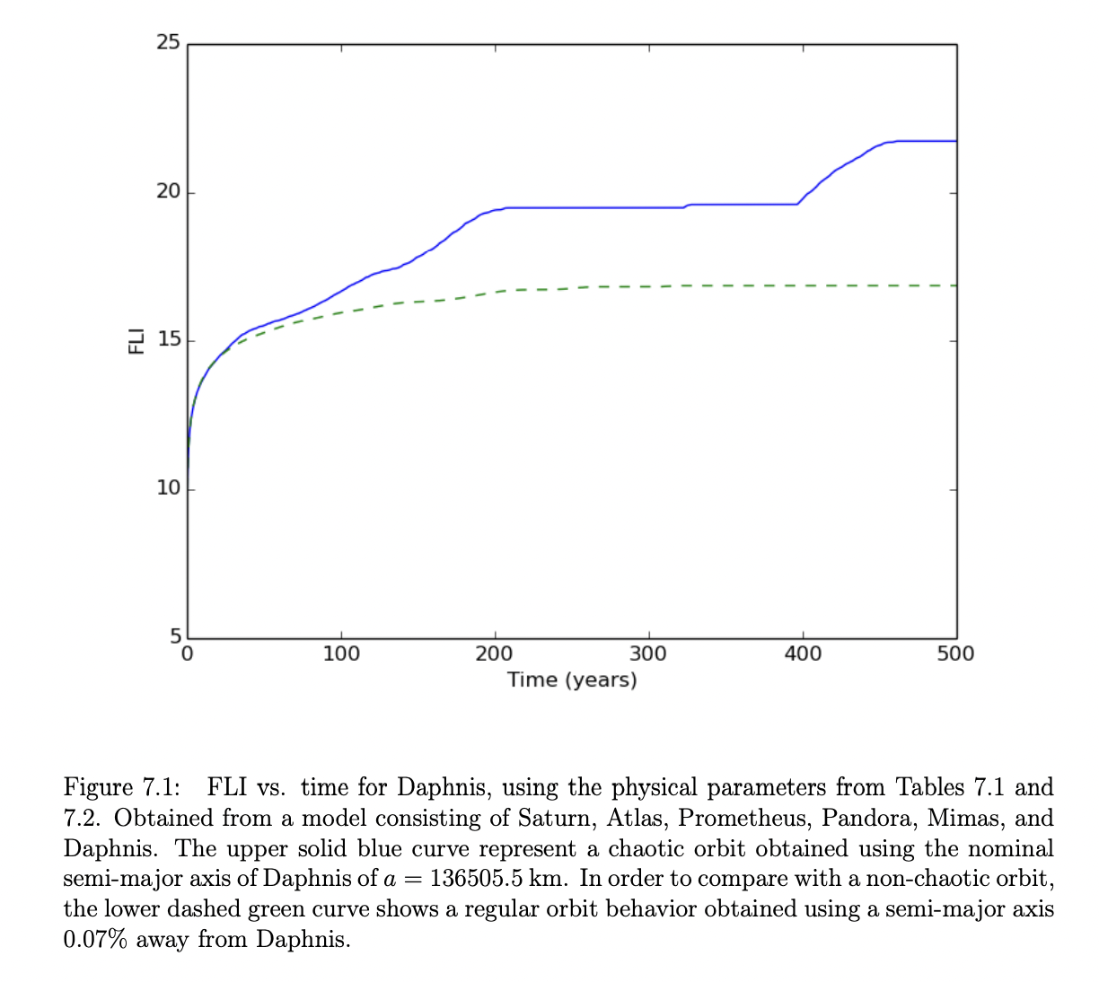
Cont. Daphnis
Between 2004 and 2014, Daphnis changed its orbit and altered the fit model that had to be used.
Within three different orbits in this time period, the semi-major axis of Daphnis changed three times and led to a hypothesized asymmetry
Found Daphnis to be in a chaotic region with a very short lyapunov time ~ 22 y
What would it take to be stable?
If its orbit be 0.07% further from saturn
if Prometheus and Atlas did not exist

Slide 8
Works Cited
[1] https://science.nasa.gov/saturn/moons/pan/
[2] https://science.nasa.gov/saturn/moons/daphnis/
[3] https://science.nasa.gov/saturn/moons/prometheus/
[4] https://www.nasa.gov/image-article/pan-revealed/
[5] https://theplanets.org/daphnis-moon/
[6] https://astronomynow.com/2015/08/24/origin-of-saturns-f-ring-and-its-shepherd-moons-revealed/
[7] https://www.universityofcalifornia.edu/news/how-saturn-got-its-rings#:~:text=Scientists%20now%20show%20that%20the,chrysalis%20transforms%20into%20a%20butterfly.
[8] https://www.aanda.org/articles/aa/full_html/2010/15/aa12734-09/aa12734-09.html

